Slide 1
JAVA CONCEPTS

Slide 2
TOPICS
INTRODUCTION TO JAVA
FEATURES OF JAVA
IMPLEMENTATION OF JAVA APLLICATION PROGRAM
JDK,JRE,JVM
TOKENS
JAVA METHODS
DATA TYPES
OPERATORS
CONTROL STATEMENTS
JAVA ARRAYS

Slide 3
INTRODUCTION TO JAVA:-
Java is a high-level programming language that was developed by James Gosling in the year 1982.
James Gosling is known as the father of Java. Before Java, its name was Oak. Since Oak was already a registered company, so James Gosling and his team changed the name from Oak to Java.
It is based on the principles of object-oriented programming and can be used to develop large-scale applications.
Java is general-purpose programming language made for developers to write once run anywhere(WORA) that is compiled Java code can run on all platforms that support Java.
Java applications are compiled to byte code that can run on any Java Virtual Machine.

Slide 4
FEATURES OF JAVA:-
There are many features of java. They are also known as java buzzwords.
1. Object Oriented 2. Simple 3. Secured 4. Platform Independent 5. Robust 6. Portable 7. Architecture Neutral 8. Dynamic 9. Interpreted 10. High Performance 11. Multithreaded 12. Distributed

Slide 5
Object Oriented:- In java, everything is an object which has some data and behavior. Java can be easily extended as it is based on Object Model. Object , Class, Inheritance, polymorphism, Abstraction, Encapsulation are some basic concept of OOP’s.
2) Simple: Java is designed to be easy to learn and use, with simple syntax and clear documentation.
3) Secure: Java provides a secure environment for developing and executing applications, with built-in security features like bytecode verification and a security manager.
4) Platform Independent: Unlike other programming languages such as C, C++ etc. which are compiled into platform specific machines. Java is guaranteed to be write-once, run-anywhere language.
5) Robust: Java has strong error-checking mechanisms that catch and handle errors at compile time and runtime, making it less prone to crashes or errors. But the main areas which Java improved were Memory Management and mishandled Exceptions by introducing automatic Garbage Collector and Exception Handling.
6) Portable: Java Byte code can be carried to any platform. No implementation dependent features. Everything related to storage is predefined, example: size of primitive data types.

Slide 6
7) Architecture Neutral:- Java code can be compiled into byte code that can run on any architecture, making it highly flexible and portable.
8. Dynamic:- Java is a dynamic language. It supports the dynamic loading of classes. It means classes are loaded on demand. It also supports functions from its native languages, i.e., C and C++. Java supports dynamic compilation and automatic memory management (garbage collection).
9. Interpreted:-After a Java program is compiled, it is transformed into bytecode, which can be understood by the Java Runtime Environment (JRE). The bytecode is then interpreted by the Java Virtual Machine (JVM), effectively making Java an interpreted language.
10. High Performance:- Java has a fast execution speed due to its Just-In-Time (JIT) compilation and efficient garbage collection mechanism.
11. Multithreaded:- Java multithreading feature makes it possible to write program that can do many tasks simultaneously. Benefit of multithreading is that it utilizes same memory and other resources to execute multiple threads at the same time, like While typing, grammatical errors are checked along.
12. Distributed:- Java is distributed because it facilitates users to create distributed applications in Java. RMI and EJB are used for creating distributed applications. This feature of Java makes us able to access files by calling the methods from any machine on the internet.

Slide 7
Implementation of a Java application program:
1. Creating the program 2. Compiling the program 3. Running the program
Anatomy of java program:-
documentation section
package statement
import statements
interface statements
class definitions
Main Method class
{
Main Method Definition
}
Steps to compile and run a JAVA Program
1.save code with java extension
MyFirstApp.Java
2.compile
javac MyFirstApp.java
3.Run
java MyFirstApp
4.Output.

Slide 8
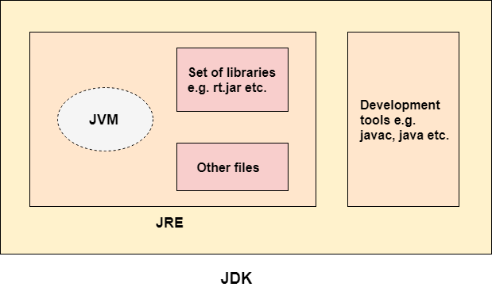
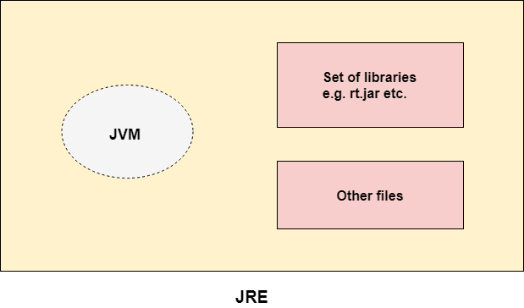
JDK , JRE , JVM,JIT:
JDK
JDK is java development kit.
JDK contains JRE+ compilers + debug etc..
JDK (Java Development Kit) is a Kit that provides the environment to develop and execute(run) the Java program
JRE
JRE (Java Runtime Environment) is an installation package that provides an environment to only run the java program .
JRE is only used by those who only want to run Java programs that are end-users of your system.
The Java Runtime Environment is a set of software tools which are used for developing Java applications.
It is the implementation of JVM.
It physically exists.
It contains a set of libraries + other files that JVM uses at runtime.

Slide 9
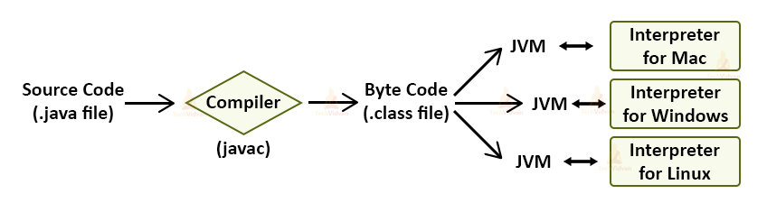
JVM
JVM (Java Virtual Machine) is a very important part of both JDK and JRE because it is contained or inbuilt in both.
Java program run using JRE or JDK goes into JVM and JVM is responsible for executing the java program line by line, hence it is also known as an interpreter.
JVM is java virtual machine, translate bytecode to machine code.
It is called a virtual machine because it doesn't physically exist.
JIT
JIT is just- in-time COMPILER improve the performance of java program by compiling bytecode into native machine code at runtime
And identify the hostsport(parts of program)

Slide 10
TOKENS:-
Tokens is a smallest individual units of a program that are recognize by compilers.
Types of Tokens:-
Keywords
Identifiers
Literals
Operators
Special Symbols
Keywords: These are the pre-defined reserved words of any programming language. Each keyword has a special meaning. It is always written in lower case.

Slide 11
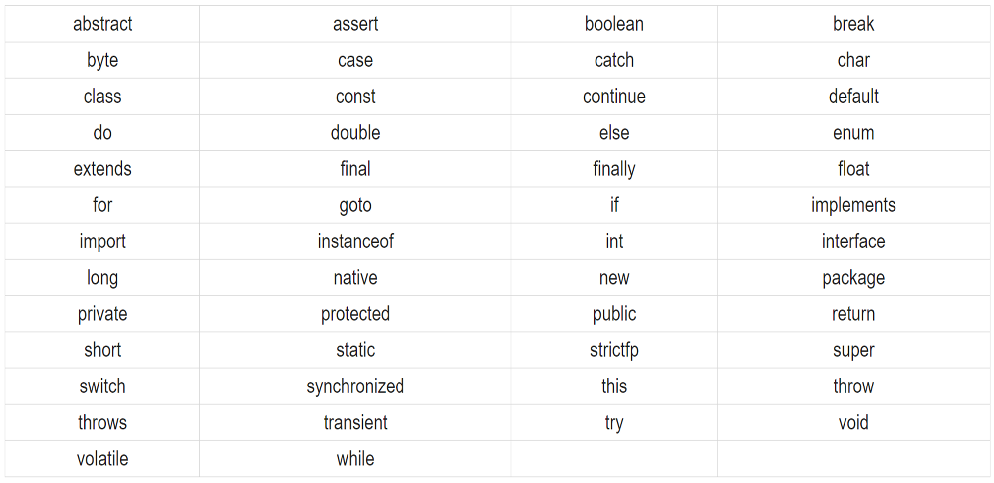
Java provides the following keywords:
Identifiers:- Identifiers are the name given to programming elements such as objects, variables, methods, packages etc..
Identifier rules:
1.They can have alphabets, digits, underscore and dollar symbol.
2.They must not begin with digit
3.Keywords cannot be used as identifiers
4.whitespace characters are also not allowed

Slide 12
LITERALS: Literals are any constant value in the program like 9,true,false,null,etc..
Operators: symbols that are used to perform certain mathematical and logical operations those are called as operators.
TYPES OF OPERATORS ARE:-
1.Arthimatic operator
2. bitwise operator
3. Assignment operator
4. Relational operator
5. logical operator
6.ternary operator
7.Increment/Decrement operators
Special Symbols: special symbols are few character's which have special meaning known to java compiler and cannot be used for other purpose like..(){}[]

Slide 13
JAVA METHODS
A method is a block of code or collection of statements or a set of code grouped together to perform a certain task or operation.
It is used to achieve the reusability of code. We write a method once and use it many times.
It also provides the easy modification and readability of code, just by adding or removing a chunk of code.
The method is executed only when we call or invoke it.
The most important method in Java is the main() method.
A Method has two parts:
1.Method header.
2.Method body.

Slide 14
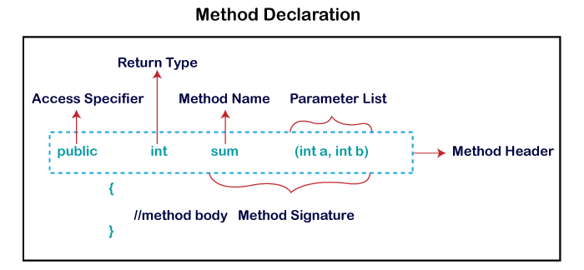
Method Declaration:-
Method declaration has six Components
Access Modifier
Return type
Method Name
Parameter list
Exception list
Method body

Slide 15
NAMING CONVENTIONS:-
Names of packages in Java are written in lower case letters.
2. Each word of class names and interface names start with a upper case letter.
3. The first word of a variable and method name is in lower case letters; then from second word onwards, each new word starts with a upper case letter.
4. constants should be written by using all upper case letters.
5.All keywords should be written by using all lower case letters.
Data Types in Java:
Data types specify the different sizes and values that can be stored in the variable. There are two types of data types in Java:
Primitive data types
Non-primitive data types:

Slide 16
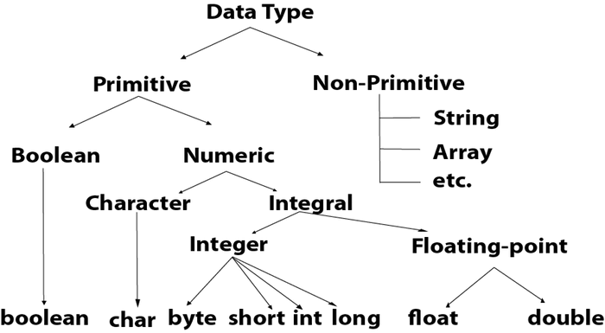
Primitive data types:- predefined in java
>-- Numeric:-
integer:-number without decimal point
byte:-size:1,range:-(-2^7 to 2^7-1)
short:-size:2,range:-(-2^15 to 2^15-1)
int:-size:4,range:-(-2^31 to 2^31-1)
long:-size:8,range:-(-2^63 to 2^63-1)
floating point:-
double:-8byte
float:-4byte
>-- Non-numeric:-
Boolean:-1 byte(true and false)
char:-2byte
Non-primitive data types:- user-defined
string
arrays
user defined class

Slide 17
VARIABLES:- variable is a named memory location whose value can change during the execution of the program
variables must first be declare before they can be used.
syntax:- datatypes var1,var2;
ex:-int x, y
TYPE CASTING:- the process of converting one data type to another data types is know as type casting.
>--implicit (or) widening type conversion:-
* convert smaller data type to large data type
* carried out by compiler automatically
( byte>-- int>-- long>-- float>-- double)
>-- explicit (or) narrowing type conversion:-
* convert larger data type to smaller data type
* carried out by programmer using casting
OPERATERS:- symbols that are used to perform certain mathematical and logical operations those are called as operators.
TYPES OF OPERATORS:-
1.Arthimatic operator(+,-,*,/,%)
2. bitwise operator(&(AND), |(OR) , ^( Exclusive-OR), ~(complement), <<(left shift), >>(right shift))
3. Assignment operator(=, +=, -=, *=, /=, %=)
4. Relational operator(= =, >, <, >=, <=, !=)
5. logical operator(&&(logical AND), ||(logical OR), !(logical NOT))
6.ternary operator(?:)-(variable=expression ? expression:expression2)
Narrowing Type Conversion
– Programmer should describe the conversion explicitly
byte -> char
short -> byte, char
char -> byte, short
int -> byte, short, char
long -> byte, short, char, int
float -> byte, short, char, int, long
double -> byte, short, char, int, long, float
Widening Type Conversion
– Implicit conversion by compiler automatically
byte -> short, int, long, float, double
short -> int, long, float, double
char -> int, long, float, double
int -> long, float, double
long -> float, double
float -> double

Slide 18
Control statements
Control statement:- control statements are used controlling the order of execution of statement’s.
Java provides three types of control flow statements.
Decision Making /Conditional statements
1.simple if
2.if else
3. else if ladder
4. nested if
5 switch
2. Looping statements
while loop
do while loop
for loop
3. Jump statements
break statement
continue statement
Return

Slide 19
Decision Making /Conditional statements
simple if statement:-
if(condition)
{
statement block;
}
statement-X;
else if ladder
if(condition1)
{
statement1;
}
else if(condition2)
{
statement2;
}
----
--------
----------
else{
statement block n;
}
Statement x;
Nested if-else
if(condition1)
{
if(condition2)
{
Statement block 1;
}
else
{
Statement block3;
}
Statement x;
Switch statement:-
switch(expression)
{
case label 1:statementblock1
break;
case label 2:statementblock2
break;
case label 3:statementblock3
break;
----
------------
----------
default: Statement block;
}
if else statement:-
if(condition)
{
statement block1;
}
else
{
statementblock2;
}
statement-X;

Slide 20
Looping statements
1.while loop:-when we don't know how many number of times the loops is executed and depend on other like number .we use while loop
while(condition)
{
Statement block;
}
Statement-X;
2.do-while loop:- statements in the statement block gets executed at least once irrespective of condition , then we use do-while loop.
do
{
Statement block;
}
while(condition);
Statement--x;
3.for loop: when we know how many number of times the loop is executed, then for loop is used.
for(initialization ; condition ; increment/decrement section)
{
statement block;
}
statement-x;

Slide 21
Jump statements:
Jump statements are of 3 types:-
break
continue
Return
break:
break is a keyword.
break use inside the switch and inside the loops.
inside loops , the control goes to the next immediate statement of loop.
inside switch , the control comes out of the switch in which break is executed.
continue:-
Continue is a keyword.
continue use inside the loops only.
when continue execute inside of loops, the execution of the loop will be suspended for that particular iteration and control goes to next iteration.
return:-
return is a keyword
It is used to return the value where it is called
When executed , the control will goes to the where it is called.

Slide 22
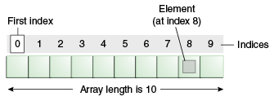
Java Arrays
Java array is an object which contains elements of a similar data type. Additionally, The elements of an array are stored in a contiguous memory location.
Array in Java is index-based, the first element of the array is stored at the 0th index, 2nd element is stored on 1st index and so on.
Types of Array in java
There are two types of array.
Single Dimensional Array
Multidimensional Array

Slide 23
Single Dimensional Array
INITIALIZE ARRAY THROUGH KEYBOARD:
for(i=0;i<array.length;i++)
array[i]=sc.nextInt();
PRINTING ARRAY ELEMENTS:-
for(int i=0;i<array.length;i++)
System.out,println(array[i]);
DECLARATION OF ARRAY:-
datatype[] array name; (int[] marks;)
or
datatype array name[]; (float temp[];)
or
datatype []array name;(string names[];)
INITIALIZATION:-
datatype[] array name;
Array name=new datatype[length];
(int[] marks;
marks =new int[5])
Multidimensional Array / Two- DIMENSIONAL ARRAY
In Two-Dimensional Array data is stored in row and column based index (also known as matrix form).
declaration:- datatype[] [] array name; or datatype [][]array name; datatype[] array name[];
Initialization:-datatypes[][]array name={……}
READING ELEMENTS THROUGH KEYBOARS:- int[][] marks=new int[2][3];
array . length:--no of row
array[0].length:---no of elements in each row

Slide 24


